Slide 1
Welcome to Rohan's
WEB!

Slide 2
WHAT'S NEXT?

Slide 3
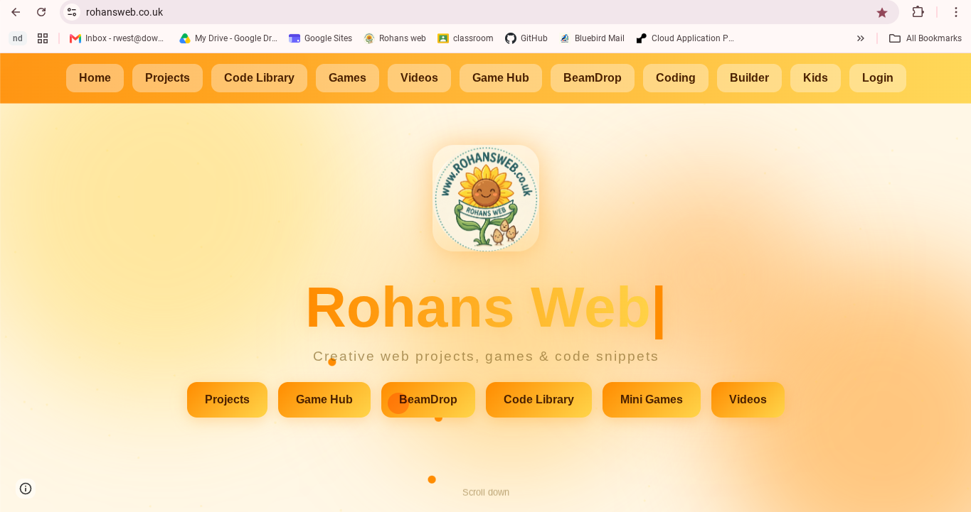
What is different?

